Slide 1

SALARY SURVEY 2021- Analysis
AJAY
Da& Ds -march

Slide 2

Project objective
The purpose of the analysis:
Understand salary trends across roles, education, gender, and experience
Help HR and professionals make informed decisions
Promote pay transparency and equity

Slide 3

Dataset Overview
Describes the dataset used:
28,084 records from a global salary survey
Key fields: Job Title, Salary, Country, Experience, Education, Gender, etc.
Notes that the data was cleaned and normalized

Slide 4

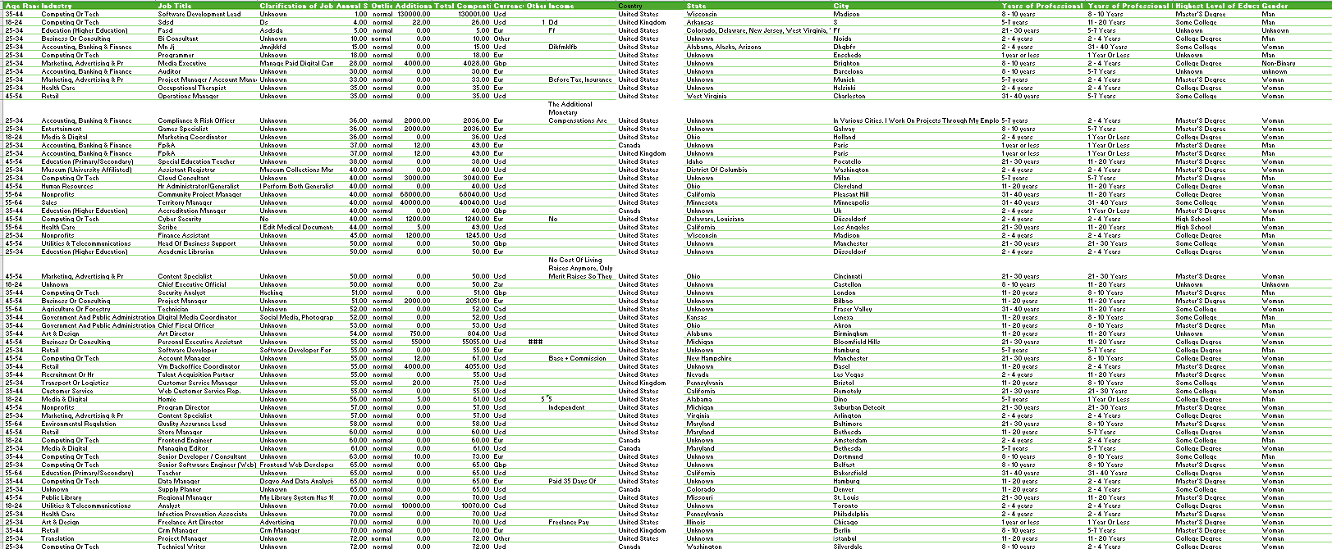
Data Cleaning
Outlines data preparation tasks
Cleaned data set
Removed null values and extreme outliers
Standardized salaries to USD
Created new metric: Total Compensation = Base Salary + Bonuses

Slide 5

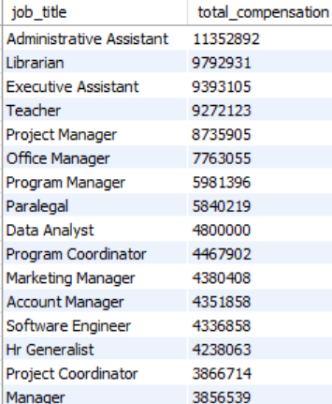
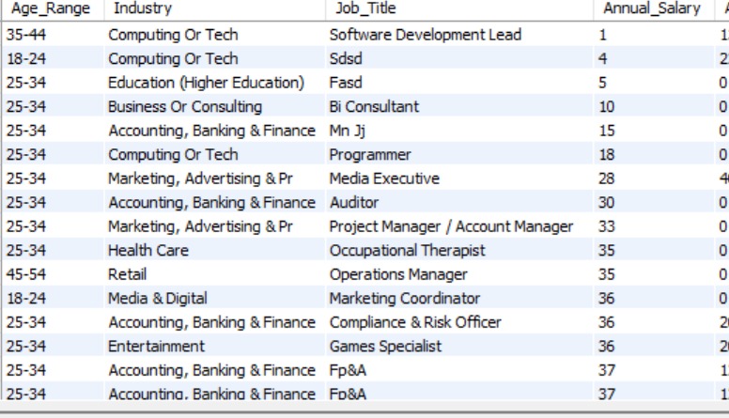
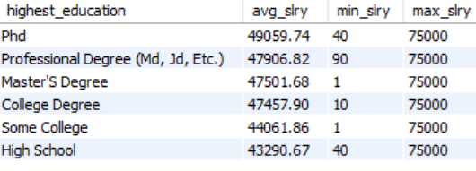
Data Import into MySQL :
Query outputs :
Covers analysis done using Excel:
Salary averages by education, gender, job title, and experience
Role distributions and compensation segmentation

Slide 6

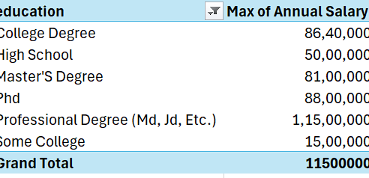
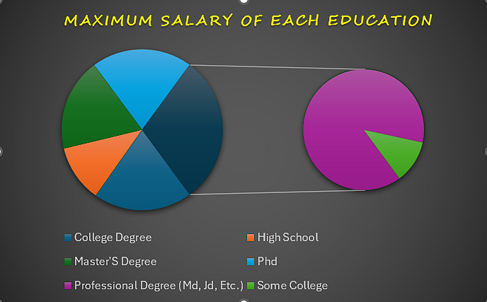
Pivot tables & Charts
Purpose of PivotTables in This Project
Summarize large data into meaningful categories
Enable quick comparison between different variables
Support decision-making through visual insights
Act as the foundation for dashboards and charts
Charts were used to visually represent key insights from the PivotTables and analysis.

Slide 7

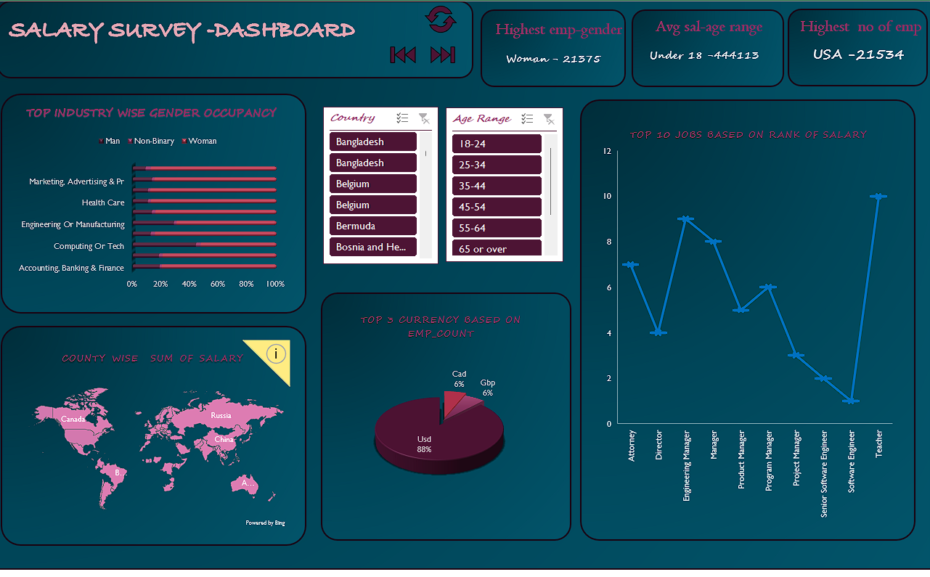
Dashboard – over view

Slide 8

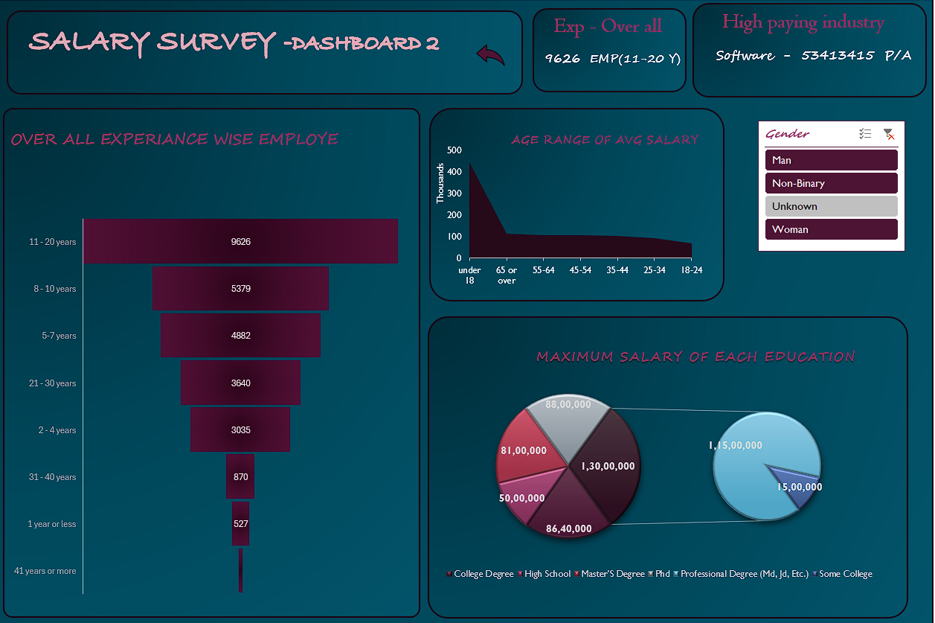
Dashboard –over view

Slide 9

Conclusion :
The salary survey data reveals clear trends related to compensation, education, gender, and industry. Some key takeaways:
Higher education levels significantly boost earning potential
Gender pay inequality persists across roles and industries
Remote work is becoming normalized, with competitive compensation
Interactive dashboards provide fast, real-time insights for HR teams

Slide 10

Thank you !!!
Any questions :

